Slide 1



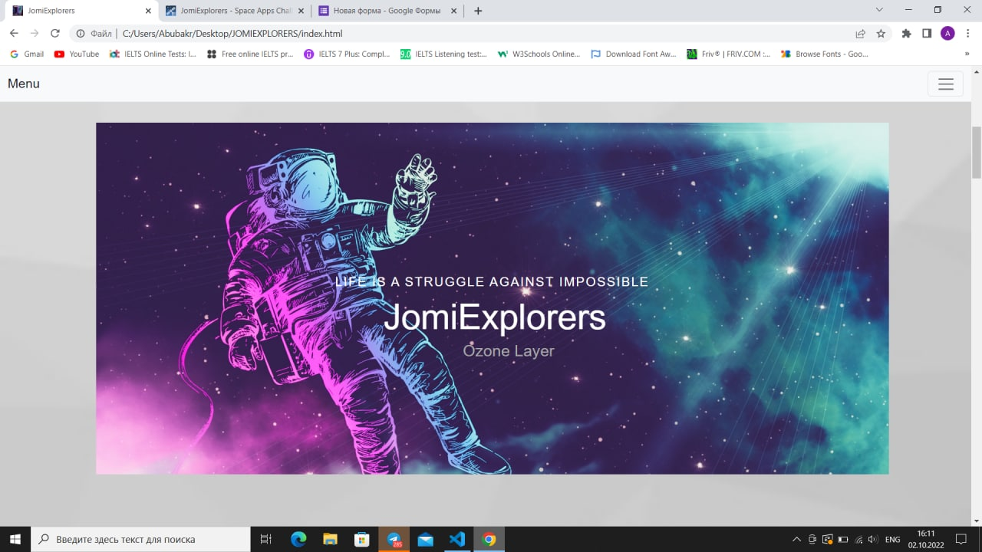
EARTH DATA ANALYSIS DEVELOPERS WANTED!
Ozone layer
Presented by JOMI EXPLORERS

Slide 2

OZONE LAYER
The ozone layer is a thin part of the Earth's atmosphere that absorbs almost all of the sun's harmful ultraviolet light.
The main cause of ozone depletion and the ozone hole is manufactured chemicals, especially manufactured halocarbon refrigerants, solvents, propellants, and foam- blowing agents (chlorofluorocarbons (CFCs), HCFCs, halons).
Ozone depletion, gradual thinning of Earth’s ozone layer in the upper atmosphere caused by the release of chemical compounds containing gaseous chlorine or bromine from industry and other human activities. The thinning is most pronounced in the polar regions, especially over Antarctica.

Slide 3
01 | Avoid the consumption of gases dangerous to ozon layer.
02 | Minimize the use of cars.
03 | Do not use cleaning products that are harmful to the environment and to us
04 | Buy local products
05 | Maintain air conditioners. As their main function cause cfcs to escape into the atmosphere.
Solutions for the problem
2 October2022

Slide 4
Future project implementation
1
Develop a common channel in telegram for like-minded people to discuss Ozone layer
2
Create web-site that contains full informartion about Ozone layer
3
Make a small quize to check a fundamental knowledge of people and importance of ozone layer
4
Try to find solution to ozone layer destruction
5
Attract people , especially teenagers to science and IT field

Slide 5
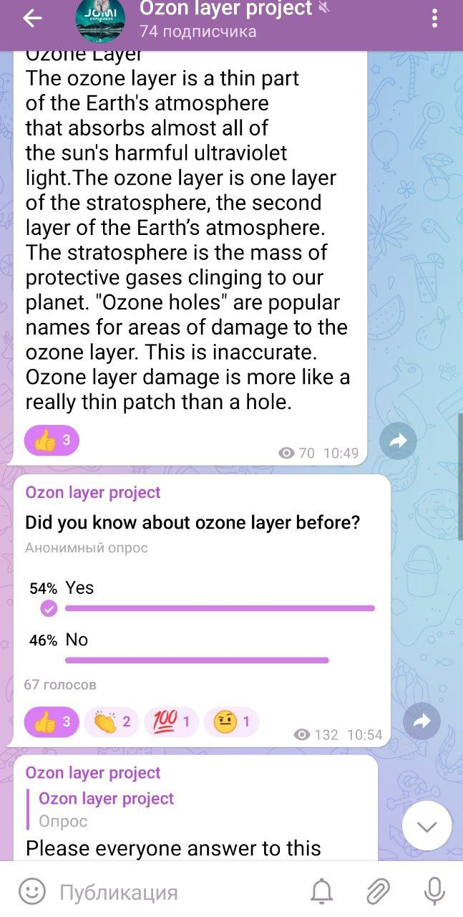
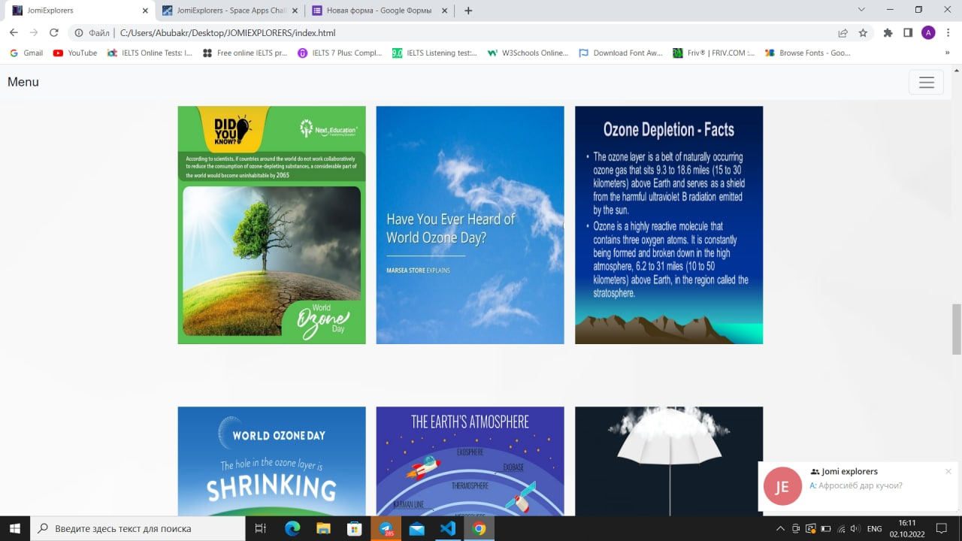
Aim of our project
Our aim is to involve people, especially teenagers to consciousness of science and IT fields. To develop a method to improve public awareness and understanding about ozone layer. Additionally, to elucidate how ozone destruction is detrimental to community.
We want to convey that people have to find solution before the issue occurs.

Slide 6
Meat the team
Speaker – Oliha Nuridinova
Website designer – Ruken Chelik
Information searcher – Saidzoda Afrosiyob
Captain – Nabiev Firuz
Programmer – Farrukh Abubakr
Project manager – Jaborzoda Munavvara

Slide 7
THANK
YOU
spaceappschallenge.org

